Slide 1
Dynamic Programming
Principle of optimality
0/1 Knapsack
Largest Common Subsequence
Travelling Salesperson Problem
Multistage Graph problem (using Forward computation)
(Ref. Horowithz Sahni and Parag Dave )

Slide 2
Dynamic Programming
Dynamic programming is typically applied to optimization problem.
Dynamic Programming is an algorithm design method that can be used when the solution to a problem may be viewed as the result of a sequence of decisions

Slide 3
Why Dynamic Programming?
Divide-and-Conquer : a top-down approach.
partitions a problem into independent subproblems
Greedy method : only works with the local information
Dynamic programming :a bottom-up approach.
Solutions for smaller instances are stored in a table for later use.

Slide 4
Comparison with divide-and-conquer
Divide-and-conquer algorithms split a problem into separate subproblems, solve the subproblems, and combine the results for a solution to the original problem
Example: Quicksort
Example: Mergesort
Example: Binary search
Divide-and-conquer algorithms can be thought of as top-down algorithms
In contrast, a dynamic programming algorithm proceeds by solving small problems, then combining them to find the solution to larger problems
Dynamic programming can be thought of as bottom-up
4

Slide 5
Comparison with Greedy Approach
Greedy and Dynamic Programming are methods for solving optimization problems.
However, often you need to use dynamic programming since the optimal solution cannot be guaranteed by a greedy algorithm.
Dynamic Programming provides efficient solutions for some problems for which a brute force approach would be very slow.
To use Dynamic Programming we need only show that the principle of optimality applies to the problem.
Notes:
5

Slide 6
Elements of Dynamic Programming …
Principle of optimality
In an optimal sequence of decisions or choices, each subsequence must also be optimal.
Memorization (for overlapping sub-problems)
avoid calculating the same thing twice,
usually by keeping a table of know results that fills up as sub-instances are solved.

Slide 7
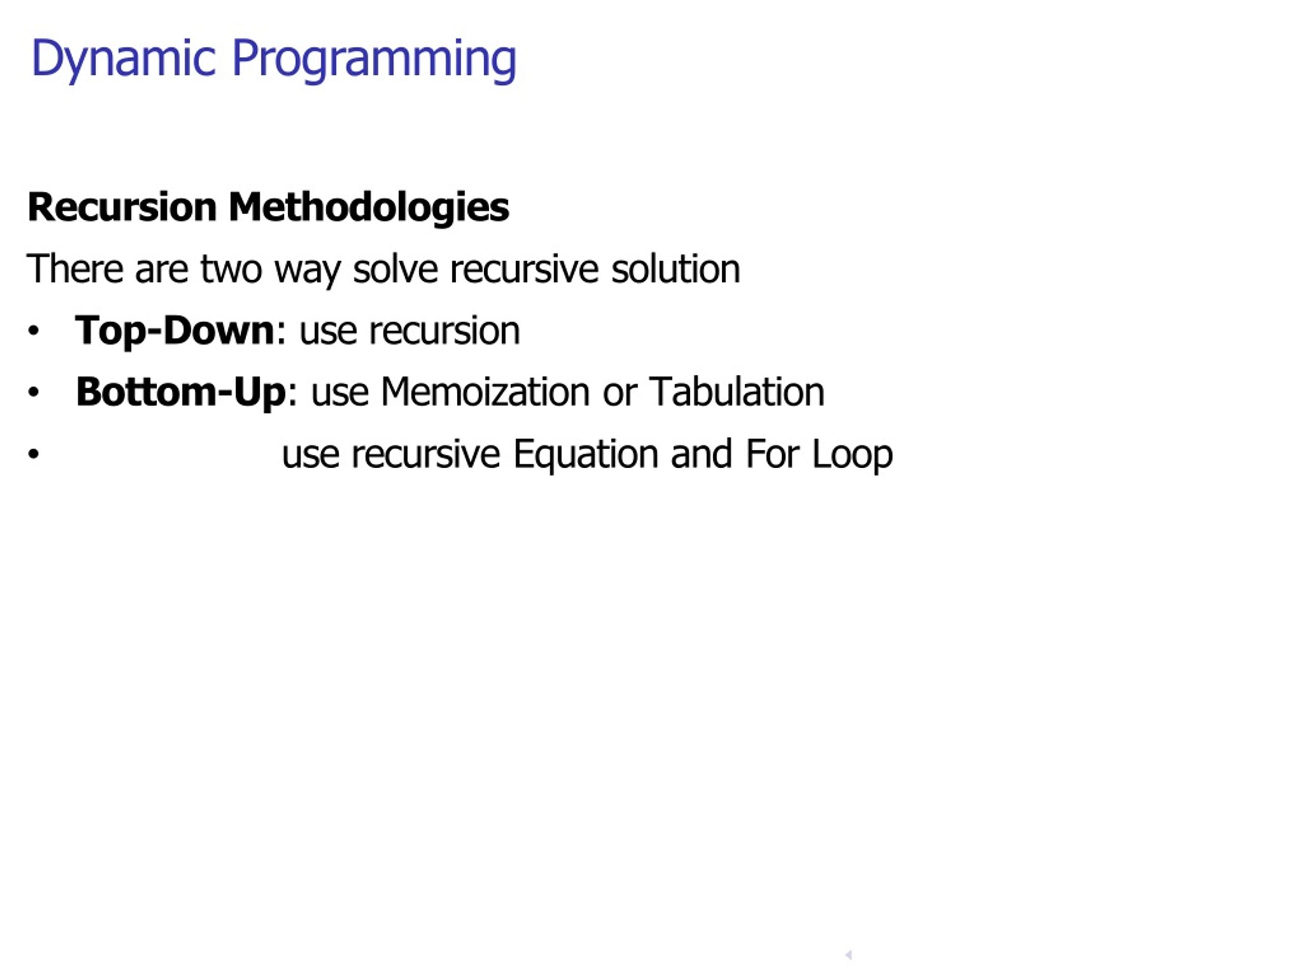

Slide 8
Dynamic Programming
Dynamic Programming is an algorithm design method that can be used when the solution to a problem may be viewed as the result of a sequence of decisions
7 -8
Notes:
8

Slide 9
Principle of optimality
Principle of optimality: Suppose that in solving a problem, we have to make a sequence of decisions D₁, D₂, …, D_{n}. If this sequence is optimal, then the last k decisions, 1 < k < n must be optimal.
e.g. the shortest path problem
If i, i₁, i₂, …, j is a shortest path from i to j, then i₁, i₂, …, j must be a shortest path from i₁ to j
In summary, if a problem can be described by a multistage graph, then it can be solved by dynamic programming.
7 -9
Notes:
9

Slide 10
Fibonacci series
Recall definition of Fibonacci numbers:
f(0) = 0
f(1) = 1
f(n) = f(n-1) + f(n-2) for n ≥ 1
Computing the n^{th} Fibonacci number recursively (top-down): f(n)
f(n-1) + f(n-2)
f(n-2) + f(n-3) f(n-3) + f(n-4)
...

Slide 11
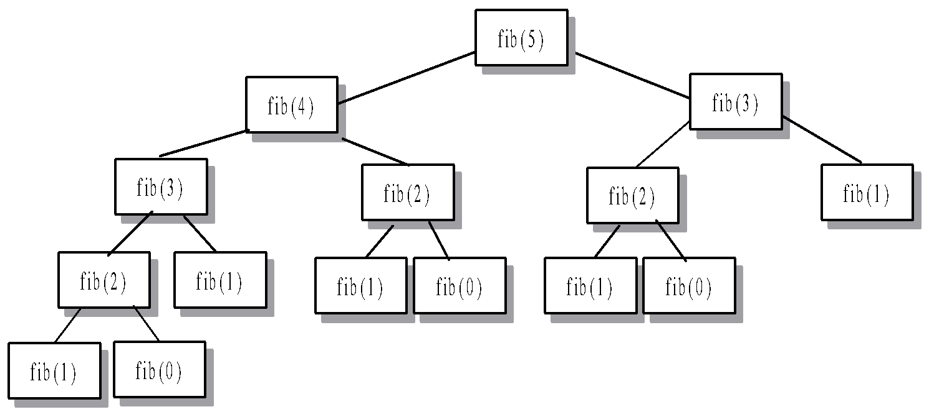
Recursive calls for fib
Total calls-15
Master theorem
T(n)=2T(n-1)+1
=O(2^{n})
int Fib(int n)
{ if (n <= 1)
return n;
return Fib(n - 2) + Fib(n - 1); }

Slide 12
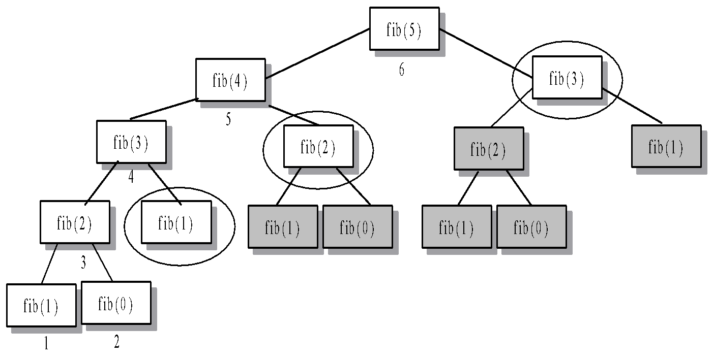
fib Using Dynamic Programming
Total calls-n+1
=O(n)
-1 | -1 | -1 | -1 | -1 | -1
0 1 2 3 4 5

Slide 13
fib Using tabulation method
Int fib(int n)
{
if n<=1
return n;
F[0]=0;F[1]=1;
for(int i=2;i<=n;i++)
F[i]=F[i-2]+F[i-1];
return F[n];
}
0 | 1 | 1 | 2 | 3 | 5
0 1 2 3 4 5

Slide 14
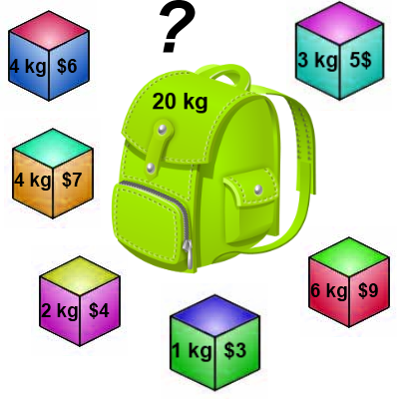
Knapsack 0-1 Problem
The difference between this problem and the fractional knapsack one is that you CANNOT take a fraction of an item.
You can either take it or not.
Hence the name Knapsack 0-1 problem.

Slide 15
Knapsack 0-1 Problem
As we did before we are going to solve the problem in terms of sub-problems.
So let’s try to do that…
Our first attempt might be to characterize a sub-problem as follows:
Let S_{k} be the optimal subset of elements from {I₀, I₁, …, I_{k}}.
What we find is that the optimal subset from the elements {I₀, I₁, …, I_{k+1}} may not correspond to the optimal subset of elements from {I₀, I₁, …, I_{k}} in any regular pattern.
Basically, the solution to the optimization problem for S_{k+1} might NOT contain the optimal solution from problem S_{k}.

Slide 16
Knapsack 0-1 Problem
Let’s illustrate that point with an example:
Item Weight Value
I₀ 3 10
I₁ 8 4
I₂ 9 9
I₃ 8 11
The maximum weight the knapsack can hold is 20.
The best set of items from {I₀, I₁, I₂} is {I₀, I₁, I₂}
BUT the best set of items from {I₀, I₁, I₂, I₃} is {I₀, I₂, I₃}.
In this example, note that this optimal solution, {I₀, I₂, I₃}, does NOT build upon the previous optimal solution, {I₀, I₁, I₂}.
(Instead it build's upon the solution, {I₀, I₂}, which is really the optimal subset of {I₀, I₁, I₂} with weight 12 or less.)

Slide 17
Knapsack 0-1 problem
So now we must re-work the way we build upon previous sub-problems…
Let B[k, w] represent the maximum total value of a subset S_{k} with weight w.
Our goal is to find B[n, W], where n is the total number of items and W is the maximal weight the knapsack can carry.
So our recursive formula for subproblems:
B[k, w] = B[k - 1,w], if w_{k} > w
= max { B[k - 1,w], B[k - 1,w - w_{k}] + v_{k}}, otherwise
this means that the best subset of S_{k} that has total weight w is:
The best subset of S_{k-1} that has total weight w, or
The best subset of S_{k-1} that has total weight w-w_{k} plus the item k

Slide 18
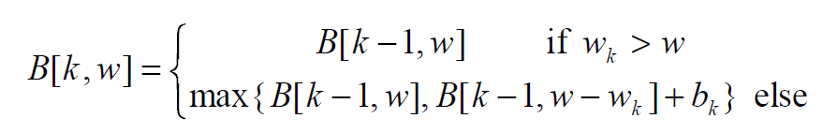
Knapsack 0-1 Problem – Recursive Formula
The best subset of S_{k} that has the total weight w, either contains item k or not.
First case: w_{k} > w
Item k can’t be part of the solution! If it was the total weight would be > w, which is unacceptable.
Second case: w_{k} ≤ w
Then the item k can be in the solution, and we choose the case with greater value.

Slide 19
Knapsack 0-1 Example
i / w | 0 | 1 | 2 | 3 | 4 | 5
0 | 0 | 0 | 0 | 0 | 0 | 0
1 | 0
2 | 0
3 | 0
4 | 0
// Initialize the base cases
for w = 0 to W
B[0,w] = 0
for i = 1 to n
B[i,0] = 0

Slide 20
Knapsack 0-1 Algorithm
for w = 0 to W { // Initialize 1st row to 0’s
B[0,w] = 0
}
for i = 1 to n { // Initialize 1st column to 0’s
B[i,0] = 0
}
for i = 1 to n {
for w = 0 to W {
if w_{i} <= w { //item i can be in the solution
if v_{i} + B[i-1,w-w_{i}] > B[i-1,w]
B[i,w] = v_{i} + B[i-1,w- w_{i}]
else
B[i,w] = B[i-1,w]
}
else B[i,w] = B[i-1,w] // w_{i} > w
}
}

Slide 21
Knapsack 0-1 Problem
Let’s run our algorithm on the following data:
n = 4 (# of elements)
W = 5 (max weight)
Elements (weight, value):
(2,3), (3,4), (4,5), (5,6)

Slide 22
Knapsack 0-1 Example
Items:
1: (2,3)
2: (3,4)
3: (4,5)
4: (5,6)
i / w | 0 | 1 | 2 | 3 | 4 | 5
0 | 0 | 0 | 0 | 0 | 0 | 0
1 | 0
2 | 0
3 | 0
4 | 0
i / w | 0 | 1 | 2 | 3 | 4 | 5
0 | 0 | 0 | 0 | 0 | 0 | 0
1 | 0 | 0
2 | 0
3 | 0
4 | 0
i = 1
v_{i} = 3
w_{i} = 2
w = 1
w-w_{i} = -1
if w_{i} <= w //item i can be in the solution
if v_{i} + B[i-1,w-w_{i}] > B[i-1,w]
B[i,w] = v_{i} + B[i-1,w- w_{i}]
else
B[i,w] = B[i-1,w]
else B[i,w] = B[i-1,w] // w_{i} > w

Slide 23
Knapsack 0-1 Example
Items:
1: (2,3)
2: (3,4)
3: (4,5)
4: (5,6)
i / w | 0 | 1 | 2 | 3 | 4 | 5
0 | 0 | 0 | 0 | 0 | 0 | 0
1 | 0 | 0
2 | 0
3 | 0
4 | 0
i / w | 0 | 1 | 2 | 3 | 4 | 5
0 | 0 | 0 | 0 | 0 | 0 | 0
1 | 0 | 0 | 3
2 | 0
3 | 0
4 | 0
i = 1
v_{i} = 3
w_{i} = 2
w = 2
w-w_{i} = 0
if w_{i} <= w //item i can be in the solution
if v_{i} + B[i-1,w-w_{i}] > B[i-1,w]
B[i,w] = v_{i} + B[i-1,w- w_{i}]
else
B[i,w] = B[i-1,w]
else B[i,w] = B[i-1,w] // w_{i} > w
if w_{i} <= w //item i can be in the solution
if v_{i} + B[i-1,w-w_{i}] > B[i-1,w]
B[i,w] = v_{i} + B[i-1,w- w_{i}]
else
B[i,w] = B[i-1,w]
else B[i,w] = B[i-1,w] // w_{i} > w

Slide 24
Knapsack 0-1 Example
Items:
1: (2,3)
2: (3,4)
3: (4,5)
4: (5,6)
i / w | 0 | 1 | 2 | 3 | 4 | 5
0 | 0 | 0 | 0 | 0 | 0 | 0
1 | 0 | 0 | 3
2 | 0
3 | 0
4 | 0
i / w | 0 | 1 | 2 | 3 | 4 | 5
0 | 0 | 0 | 0 | 0 | 0 | 0
1 | 0 | 0 | 3 | 3
2 | 0
3 | 0
4 | 0
i = 1
v_{i} = 3
w_{i} = 2
w = 3
w-w_{i} = 1
if w_{i} <= w //item i can be in the solution
if v_{i} + B[i-1,w-w_{i}] > B[i-1,w]
B[i,w] = v_{i} + B[i-1,w- w_{i}]
else
B[i,w] = B[i-1,w]
else B[i,w] = B[i-1,w] // w_{i} > w

Slide 25
Knapsack 0-1 Example
Items:
1: (2,3)
2: (3,4)
3: (4,5)
4: (5,6)
i / w | 0 | 1 | 2 | 3 | 4 | 5
0 | 0 | 0 | 0 | 0 | 0 | 0
1 | 0 | 0 | 3 | 3
2 | 0
3 | 0
4 | 0
i / w | 0 | 1 | 2 | 3 | 4 | 5
0 | 0 | 0 | 0 | 0 | 0 | 0
1 | 0 | 0 | 3 | 3 | 3
2 | 0
3 | 0
4 | 0
i = 1
v_{i} = 3
w_{i} = 2
w = 4
w-w_{i} = 2
if w_{i} <= w //item i can be in the solution
if v_{i} + B[i-1,w-w_{i}] > B[i-1,w]
B[i,w] = v_{i} + B[i-1,w- w_{i}]
else
B[i,w] = B[i-1,w]
else B[i,w] = B[i-1,w] // w_{i} > w

Slide 26
Knapsack 0-1 Example
Items:
1: (2,3)
2: (3,4)
3: (4,5)
4: (5,6)
i / w | 0 | 1 | 2 | 3 | 4 | 5
0 | 0 | 0 | 0 | 0 | 0 | 0
1 | 0 | 0 | 3 | 3 | 3
2 | 0
3 | 0
4 | 0
i / w | 0 | 1 | 2 | 3 | 4 | 5
0 | 0 | 0 | 0 | 0 | 0 | 0
1 | 0 | 0 | 3 | 3 | 3 | 3
2 | 0
3 | 0
4 | 0
i = 1
v_{i} = 3
w_{i} = 2
w = 5
w-w_{i} = 3
if w_{i} <= w //item i can be in the solution
if v_{i} + B[i-1,w-w_{i}] > B[i-1,w]
B[i,w] = v_{i} + B[i-1,w- w_{i}]
else
B[i,w] = B[i-1,w]
else B[i,w] = B[i-1,w] // w_{i} > w

Slide 27
Knapsack 0-1 Example
Items:
1: (2,3)
2: (3,4)
3: (4,5)
4: (5,6)
i / w | 0 | 1 | 2 | 3 | 4 | 5
0 | 0 | 0 | 0 | 0 | 0 | 0
1 | 0 | 0 | 3 | 3 | 3 | 3
2 | 0
3 | 0
4 | 0
i / w | 0 | 1 | 2 | 3 | 4 | 5
0 | 0 | 0 | 0 | 0 | 0 | 0
1 | 0 | 0 | 3 | 3 | 3 | 3
2 | 0 | 0
3 | 0
4 | 0
i = 2
v_{i} = 4
w_{i} = 3
w = 1
w-w_{i} = -2
if w_{i} <= w //item i can be in the solution
if v_{i} + B[i-1,w-w_{i}] > B[i-1,w]
B[i,w] = v_{i} + B[i-1,w- w_{i}]
else
B[i,w] = B[i-1,w]
else B[i,w] = B[i-1,w] // w_{i} > w
if w_{i} <= w //item i can be in the solution
if v_{i} + B[i-1,w-w_{i}] > B[i-1,w]
B[i,w] = v_{i} + B[i-1,w- w_{i}]
else
B[i,w] = B[i-1,w]
else B[i,w] = B[i-1,w] // w_{i} > w

Slide 28
Knapsack 0-1 Example
Items:
1: (2,3)
2: (3,4)
3: (4,5)
4: (5,6)
i / w | 0 | 1 | 2 | 3 | 4 | 5
0 | 0 | 0 | 0 | 0 | 0 | 0
1 | 0 | 0 | 3 | 3 | 3 | 3
2 | 0 | 0
3 | 0
4 | 0
i / w | 0 | 1 | 2 | 3 | 4 | 5
0 | 0 | 0 | 0 | 0 | 0 | 0
1 | 0 | 0 | 3 | 3 | 3 | 3
2 | 0 | 0 | 3
3 | 0
4 | 0
i = 2
v_{i} = 4
w_{i} = 3
w = 2
w-w_{i} = -1
if w_{i} <= w //item i can be in the solution
if v_{i} + B[i-1,w-w_{i}] > B[i-1,w]
B[i,w] = v_{i} + B[i-1,w- w_{i}]
else
B[i,w] = B[i-1,w]
else B[i,w] = B[i-1,w] // w_{i} > w

Slide 29
Knapsack 0-1 Example
Items:
1: (2,3)
2: (3,4)
3: (4,5)
4: (5,6)
i / w | 0 | 1 | 2 | 3 | 4 | 5
0 | 0 | 0 | 0 | 0 | 0 | 0
1 | 0 | 0 | 3 | 3 | 3 | 3
2 | 0 | 0 | 3
3 | 0
4 | 0
i / w | 0 | 1 | 2 | 3 | 4 | 5
0 | 0 | 0 | 0 | 0 | 0 | 0
1 | 0 | 0 | 3 | 3 | 3 | 3
2 | 0 | 0 | 3 | 4
3 | 0
4 | 0
i = 2
v_{i} = 4
w_{i} = 3
w = 3
w-w_{i} = 0
if w_{i} <= w //item i can be in the solution
if v_{i} + B[i-1,w-w_{i}] > B[i-1,w]
B[i,w] = v_{i} + B[i-1,w- w_{i}]
else
B[i,w] = B[i-1,w]
else B[i,w] = B[i-1,w] // w_{i} > w
if w_{i} <= w //item i can be in the solution
if v_{i} + B[i-1,w-w_{i}] > B[i-1,w]
B[i,w] = v_{i} + B[i-1,w- w_{i}]
else
B[i,w] = B[i-1,w]
else B[i,w] = B[i-1,w] // w_{i} > w

Slide 30
Knapsack 0-1 Example
Items:
1: (2,3)
2: (3,4)
3: (4,5)
4: (5,6)
i / w | 0 | 1 | 2 | 3 | 4 | 5
0 | 0 | 0 | 0 | 0 | 0 | 0
1 | 0 | 0 | 3 | 3 | 3 | 3
2 | 0 | 0 | 3 | 4
3 | 0
4 | 0
i / w | 0 | 1 | 2 | 3 | 4 | 5
0 | 0 | 0 | 0 | 0 | 0 | 0
1 | 0 | 0 | 3 | 3 | 3 | 3
2 | 0 | 0 | 3 | 4 | 4
3 | 0
4 | 0
i = 2
v_{i} = 4
w_{i} = 3
w = 4
w-w_{i} = 1
if w_{i} <= w //item i can be in the solution
if v_{i} + B[i-1,w-w_{i}] > B[i-1,w]
B[i,w] = v_{i} + B[i-1,w- w_{i}]
else
B[i,w] = B[i-1,w]
else B[i,w] = B[i-1,w] // w_{i} > w

Slide 31
Knapsack 0-1 Example
Items:
1: (2,3)
2: (3,4)
3: (4,5)
4: (5,6)
i / w | 0 | 1 | 2 | 3 | 4 | 5
0 | 0 | 0 | 0 | 0 | 0 | 0
1 | 0 | 0 | 3 | 3 | 3 | 3
2 | 0 | 0 | 3 | 4 | 4
3 | 0
4 | 0
i / w | 0 | 1 | 2 | 3 | 4 | 5
0 | 0 | 0 | 0 | 0 | 0 | 0
1 | 0 | 0 | 3 | 3 | 3 | 3
2 | 0 | 0 | 3 | 4 | 4 | 7
3 | 0
4 | 0
i = 2
v_{i} = 4
w_{i} = 3
w = 5
w-w_{i} = 2
if w_{i} <= w //item i can be in the solution
if v_{i} + B[i-1,w-w_{i}] > B[i-1,w]
B[i,w] = v_{i} + B[i-1,w- w_{i}]
else
B[i,w] = B[i-1,w]
else B[i,w] = B[i-1,w] // w_{i} > w

Slide 32
Knapsack 0-1 Example
Items:
1: (2,3)
2: (3,4)
3: (4,5)
4: (5,6)
i / w | 0 | 1 | 2 | 3 | 4 | 5
0 | 0 | 0 | 0 | 0 | 0 | 0
1 | 0 | 0 | 3 | 3 | 3 | 3
2 | 0 | 0 | 3 | 4 | 4 | 7
3 | 0
4 | 0
i / w | 0 | 1 | 2 | 3 | 4 | 5
0 | 0 | 0 | 0 | 0 | 0 | 0
1 | 0 | 0 | 3 | 3 | 3 | 3
2 | 0 | 0 | 3 | 4 | 4 | 7
3 | 0 | 0 | 3 | 4
4 | 0
i = 3
v_{i} = 5
w_{i} = 4
w = 1..3
w-w_{i} = -3..-1
if w_{i} <= w //item i can be in the solution
if v_{i} + B[i-1,w-w_{i}] > B[i-1,w]
B[i,w] = v_{i} + B[i-1,w- w_{i}]
else
B[i,w] = B[i-1,w]
else B[i,w] = B[i-1,w] // w_{i} > w
if w_{i} <= w //item i can be in the solution
if v_{i} + B[i-1,w-w_{i}] > B[i-1,w]
B[i,w] = v_{i} + B[i-1,w- w_{i}]
else
B[i,w] = B[i-1,w]
else B[i,w] = B[i-1,w] // w_{i} > w

Slide 33
Knapsack 0-1 Example
Items:
1: (2,3)
2: (3,4)
3: (4,5)
4: (5,6)
i / w | 0 | 1 | 2 | 3 | 4 | 5
0 | 0 | 0 | 0 | 0 | 0 | 0
1 | 0 | 0 | 3 | 3 | 3 | 3
2 | 0 | 0 | 3 | 4 | 4 | 7
3 | 0 | 0 | 3 | 4
4 | 0
i / w | 0 | 1 | 2 | 3 | 4 | 5
0 | 0 | 0 | 0 | 0 | 0 | 0
1 | 0 | 0 | 3 | 3 | 3 | 3
2 | 0 | 0 | 3 | 4 | 4 | 7
3 | 0 | 0 | 3 | 4 | 5
4 | 0
i = 3
v_{i} = 5
w_{i} = 4
w = 4
w-w_{i} = 0
if w_{i} <= w //item i can be in the solution
if v_{i} + B[i-1,w-w_{i}] > B[i-1,w]
B[i,w] = v_{i} + B[i-1,w- w_{i}]
else
B[i,w] = B[i-1,w]
else B[i,w] = B[i-1,w] // w_{i} > w
if w_{i} <= w //item i can be in the solution
if v_{i} + B[i-1,w-w_{i}] > B[i-1,w]
B[i,w] = v_{i} + B[i-1,w- w_{i}]
else
B[i,w] = B[i-1,w]
else B[i,w] = B[i-1,w] // w_{i} > w

Slide 34
Knapsack 0-1 Example
Items:
1: (2,3)
2: (3,4)
3: (4,5)
4: (5,6)
i / w | 0 | 1 | 2 | 3 | 4 | 5
0 | 0 | 0 | 0 | 0 | 0 | 0
1 | 0 | 0 | 3 | 3 | 3 | 3
2 | 0 | 0 | 3 | 4 | 4 | 7
3 | 0 | 0 | 3 | 4 | 5
4 | 0
i / w | 0 | 1 | 2 | 3 | 4 | 5
0 | 0 | 0 | 0 | 0 | 0 | 0
1 | 0 | 0 | 3 | 3 | 3 | 3
2 | 0 | 0 | 3 | 4 | 4 | 7
3 | 0 | 0 | 3 | 4 | 5 | 7
4 | 0
i = 3
v_{i} = 5
w_{i} = 4
w = 5
w-w_{i} = 1
if w_{i} <= w //item i can be in the solution
if v_{i} + B[i-1,w-w_{i}] > B[i-1,w]
B[i,w] = v_{i} + B[i-1,w- w_{i}]
else
B[i,w] = B[i-1,w]
else B[i,w] = B[i-1,w] // w_{i} > w
if w_{i} <= w //item i can be in the solution
if v_{i} + B[i-1,w-w_{i}] > B[i-1,w]
B[i,w] = v_{i} + B[i-1,w- w_{i}]
else
B[i,w] = B[i-1,w]
else B[i,w] = B[i-1,w] // w_{i} > w

Slide 35
Knapsack 0-1 Example
Items:
1: (2,3)
2: (3,4)
3: (4,5)
4: (5,6)
i / w | 0 | 1 | 2 | 3 | 4 | 5
0 | 0 | 0 | 0 | 0 | 0 | 0
1 | 0 | 0 | 3 | 3 | 3 | 3
2 | 0 | 0 | 3 | 4 | 4 | 7
3 | 0 | 0 | 3 | 4 | 5 | 7
4 | 0
i / w | 0 | 1 | 2 | 3 | 4 | 5
0 | 0 | 0 | 0 | 0 | 0 | 0
1 | 0 | 0 | 3 | 3 | 3 | 3
2 | 0 | 0 | 3 | 4 | 4 | 7
3 | 0 | 0 | 3 | 4 | 5 | 7
4 | 0 | 0 | 3 | 4 | 5
i = 4
v_{i} = 6
w_{i} = 5
w = 1..4
w-w_{i} = -4..-1
if w_{i} <= w //item i can be in the solution
if v_{i} + B[i-1,w-w_{i}] > B[i-1,w]
B[i,w] = v_{i} + B[i-1,w- w_{i}]
else
B[i,w] = B[i-1,w]
else B[i,w] = B[i-1,w] // w_{i} > w
if w_{i} <= w //item i can be in the solution
if v_{i} + B[i-1,w-w_{i}] > B[i-1,w]
B[i,w] = v_{i} + B[i-1,w- w_{i}]
else
B[i,w] = B[i-1,w]
else B[i,w] = B[i-1,w] // w_{i} > w

Slide 36
Knapsack 0-1 Example
Items:
1: (2,3)
2: (3,4)
3: (4,5)
4: (5,6)
i / w | 0 | 1 | 2 | 3 | 4 | 5
0 | 0 | 0 | 0 | 0 | 0 | 0
1 | 0 | 0 | 3 | 3 | 3 | 3
2 | 0 | 0 | 3 | 4 | 4 | 7
3 | 0 | 0 | 3 | 4 | 5 | 7
4 | 0 | 0 | 3 | 4 | 5
i / w | 0 | 1 | 2 | 3 | 4 | 5
0 | 0 | 0 | 0 | 0 | 0 | 0
1 | 0 | 0 | 3 | 3 | 3 | 3
2 | 0 | 0 | 3 | 4 | 4 | 7
3 | 0 | 0 | 3 | 4 | 5 | 7
4 | 0 | 0 | 3 | 4 | 5 | 7
i = 4
v_{i} = 6
w_{i} = 5
w = 5
w-w_{i} = 0
if w_{i} <= w //item i can be in the solution
if v_{i} + B[i-1,w-w_{i}] > B[i-1,w]
B[i,w] = v_{i} + B[i-1,w- w_{i}]
else
B[i,w] = B[i-1,w]
else B[i,w] = B[i-1,w] // w_{i} > w
if w_{i} <= w //item i can be in the solution
if v_{i} + B[i-1,w-w_{i}] > B[i-1,w]
B[i,w] = v_{i} + B[i-1,w- w_{i}]
else
B[i,w] = B[i-1,w]
else B[i,w] = B[i-1,w] // w_{i} > w

Slide 37
Knapsack 0-1 Example
Items:
1: (2,3)
2: (3,4)
3: (4,5)
4: (5,6)
i / w | 0 | 1 | 2 | 3 | 4 | 5
0 | 0 | 0 | 0 | 0 | 0 | 0
1 | 0 | 0 | 3 | 3 | 3 | 3
2 | 0 | 0 | 3 | 4 | 4 | 7
3 | 0 | 0 | 3 | 4 | 5 | 7
4 | 0 | 0 | 3 | 4 | 5 | 7
We’re DONE!!
The max possible value that can be carried in this knapsack is $7

Slide 38
Knapsack 0-1 Algorithm
This algorithm only finds the max possible value that can be carried in the knapsack
The value in B[n,W]
To know the items that make this maximum value, we need to trace back through the table.

Slide 39
Knapsack 0-1 Algorithm Finding the Items
Items:
1: (2,3)
2: (3,4)
3: (4,5)
4: (5,6)
Knapsack:
i / w | 0 | 1 | 2 | 3 | 4 | 5
0 | 0 | 0 | 0 | 0 | 0 | 0
1 | 0 | 0 | 3 | 3 | 3 | 3
2 | 0 | 0 | 3 | 4 | 4 | 7
3 | 0 | 0 | 3 | 4 | 5 | 7
4 | 0 | 0 | 3 | 4 | 5 | 7
i = 4
k = 5
v_{i} = 6
w_{i} = 5
B[i,k] = 7
B[i-1,k] = 7
i = n , k = W
while i, k > 0
if B[i, k] ≠ B[i-1, k] then
mark the i^{th} item as in the knapsack
i = i-1, k = k-w_{i}
else
i = i-1

Slide 40
Knapsack 0-1 Algorithm Finding the Items
Let i = n and k = W
if B[i, k] ≠ B[i-1, k] then
mark the i^{th} item as in the knapsack
i = i-1, k = k-w_{i}
else
i = i-1 // Assume the i^{th} item is not in the knapsack
// Could it be in the optimally packed knapsack?

Slide 41
Knapsack 0-1 Algorithm Finding the Items
Items:
1: (2,3)
2: (3,4)
3: (4,5)
4: (5,6)
Knapsack:
i / w | 0 | 1 | 2 | 3 | 4 | 5
0 | 0 | 0 | 0 | 0 | 0 | 0
1 | 0 | 0 | 3 | 3 | 3 | 3
2 | 0 | 0 | 3 | 4 | 4 | 7
3 | 0 | 0 | 3 | 4 | 5 | 7
4 | 0 | 0 | 3 | 4 | 5 | 7
i = 3
k = 5
v_{i} = 5
w_{i} = 4
B[i,k] = 7
B[i-1,k] = 7
i = n , k = W
while i, k > 0
if B[i, k] ≠ B[i-1, k] then
mark the i^{th} item as in the knapsack
i = i-1, k = k-w_{i}
else
i = i-1

Slide 42
Knapsack 0-1 Algorithm Finding the Items
Items:
1: (2,3)
2: (3,4)
3: (4,5)
4: (5,6)
Knapsack:
Item 2
i / w | 0 | 1 | 2 | 3 | 4 | 5
0 | 0 | 0 | 0 | 0 | 0 | 0
1 | 0 | 0 | 3 | 3 | 3 | 3
2 | 0 | 0 | 3 | 4 | 4 | 7
3 | 0 | 0 | 3 | 4 | 5 | 7
4 | 0 | 0 | 3 | 4 | 5 | 7
i = 2
k = 5
v_{i} = 4
w_{i} = 3
B[i,k] = 7
B[i-1,k] = 3
k – w_{i} = 2
i = n , k = W
while i, k > 0
if B[i, k] ≠ B[i-1, k] then
mark the i^{th} item as in the knapsack
i = i-1, k = k-w_{i}
else
i = i-1

Slide 43
Knapsack 0-1 Algorithm Finding the Items
Items:
1: (2,3)
2: (3,4)
3: (4,5)
4: (5,6)
Knapsack:
Item 2
Item 1
i / w | 0 | 1 | 2 | 3 | 4 | 5
0 | 0 | 0 | 0 | 0 | 0 | 0
1 | 0 | 0 | 3 | 3 | 3 | 3
2 | 0 | 0 | 3 | 4 | 4 | 7
3 | 0 | 0 | 3 | 4 | 5 | 7
4 | 0 | 0 | 3 | 4 | 5 | 7
i = 1
k = 2
v_{i} = 3
w_{i} = 2
B[i,k] = 3
B[i-1,k] = 0
k – w_{i} = 0
i = n , k = W
while i, k > 0
if B[i, k] ≠ B[i-1, k] then
mark the i^{th} item as in the knapsack
i = i-1, k = k-w_{i}
else
i = i-1

Slide 44
Knapsack 0-1 Algorithm Finding the Items
Items:
1: (2,3)
2: (3,4)
3: (4,5)
4: (5,6)
Knapsack:
Item 2
Item 1
i / w | 0 | 1 | 2 | 3 | 4 | 5
0 | 0 | 0 | 0 | 0 | 0 | 0
1 | 0 | 0 | 3 | 3 | 3 | 3
2 | 0 | 0 | 3 | 4 | 4 | 7
3 | 0 | 0 | 3 | 4 | 5 | 7
4 | 0 | 0 | 3 | 4 | 5 | 7
i = 1
k = 2
v_{i} = 3
w_{i} = 2
B[i,k] = 3
B[i-1,k] = 0
k – w_{i} = 0
k = 0, so we’re DONE!
The optimal knapsack should contain:
Item 1 and Item 2

Slide 45
Knapsack 0-1 Problem – Run Time
for w = 0 to W
B[0,w] = 0
for i = 1 to n
B[i,0] = 0
for i = 1 to n
for w = 0 to W
< the rest of the code >
What is the running time of this algorithm?
O(n*W)
Remember that the brute-force algorithm takes: O(2^{n})
Brute-force search or exhaustive search, also known as generate and test, is a very general problem solving, is a very general problem solving technique and algorithmic paradigm that consists of systematically enumerating all possible candidates for the solution and checking whether each candidate satisfies the problem's statement.
O(W)
O(n)
Repeat n times
O(W)

Slide 46
Knapsack 0-1
Consider the problem having weights and profits are:
Weights: {3, 4, 6, 5}
Profits: {2, 3, 1, 4}
The weight of the knapsack is 8 kg
The number of items is 4
46

Slide 47
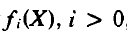
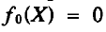
The 0-1 knapsack problem
A solution to the knapsack problem may be obtained by making a sequence
of decisions on the variables x1, x2, ... , xn. A decision on variable x; involves deciding which of the values 0 or 1 is to be assigned to it.
Let (X) be the value of an optimal solution to KNAP(l,j, X). Since the
principle of optimality holds, we obtain
For arbitrary Equation generalizes to
Equation may be solved by beginning with the knowledge
for all X and may be successively
computed using equation 2.
47

Slide 48
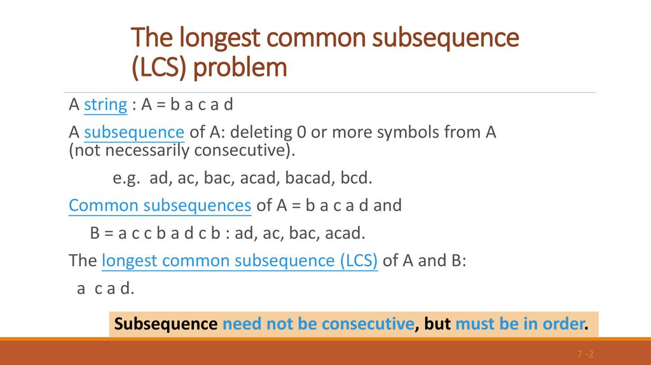

Slide 49
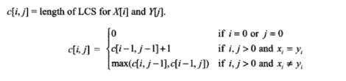
Largest/Longest Common Subsequence (LCS) (Ref. Parag Dave, page no-285)
A subsequence is a sequence that appears in the same relative order, but not necessarily contiguous. For example, “abc”, “abg”, “bdf”, “aeg”, ‘”acefg”, .. etc are subsequences of “abcdefg”.
Problem:
Given two sequences X = <x1,x2,…xm> and Y = <y1,y2,…yn> , Find the longest sub-sequence Z = <z1,….zk> that is common to X and Y.
For example:
If X = < A,B,C,B,D,A,B> and Y = <B,D,C,A,B,A>
then some common sub-sequences are:
{A} {B} {C} {D} {A,A} {B,B} {B,C,A} {B,C,A} {B,C,B,A } {B,D,A,B}
From which {B,C,B,A } {B,D,A,B} are the Longest Common sub-sequences.
C[i, j]= length of LCS for X[i] and Y[j] 🡺
49

Slide 50
String 1: a b c d e f g h i j
String 2 : c d g i
Subsequence : c d g i
d g i
String 1: a b c d e f g h i j
String 2 : e c d g i

Slide 51
String 1: a b c d e f g h i j
String 2 : e c d g i
String 1: a b c d e f g h i j
String 2 : e c d g i
Subsequence : e g i

Slide 52
String 1: a b c d e f g h i j
String 2 : e c d g i
Subsequence : e g i
c d g i

Slide 53
String 1: a b d a c e
String 2 : b a b c e
String 1: a b d a c e
String 2 : b a b c e
Subsequence : b a c e
a b c e

Slide 54
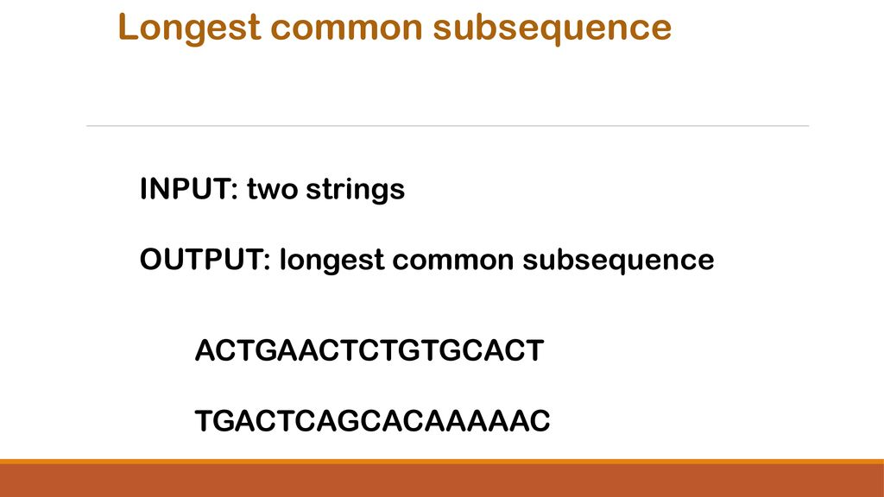

Slide 55
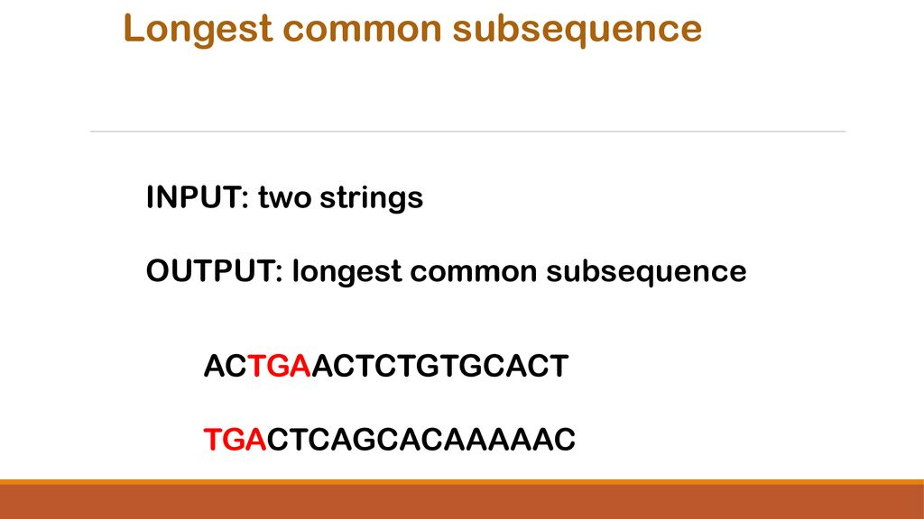

Slide 56
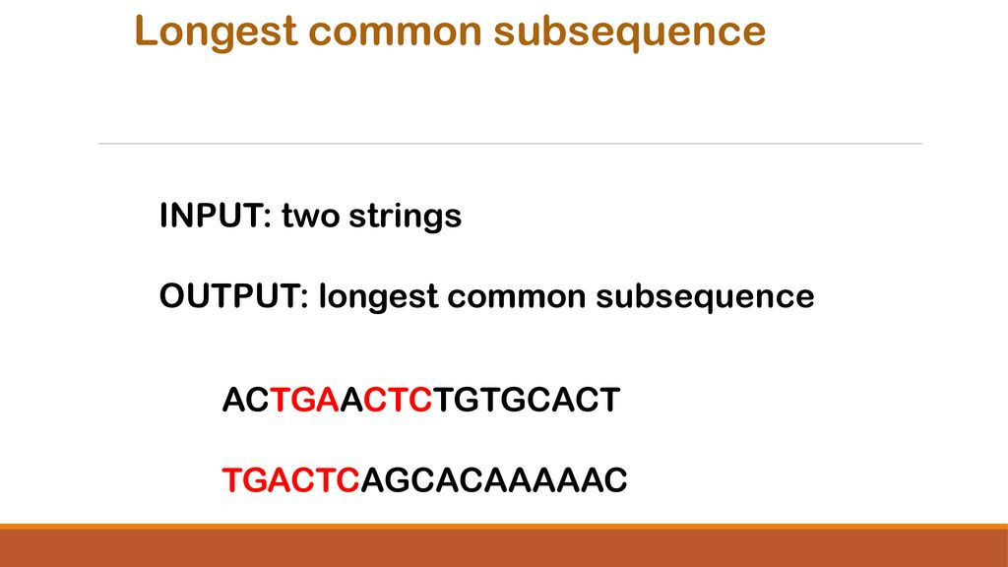

Slide 57


Slide 58
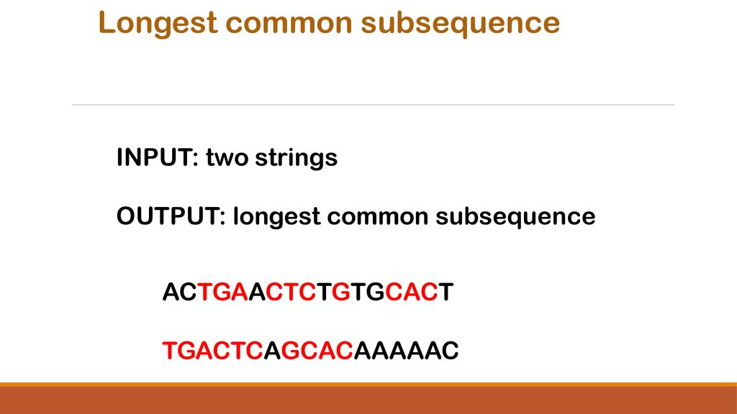

Slide 59
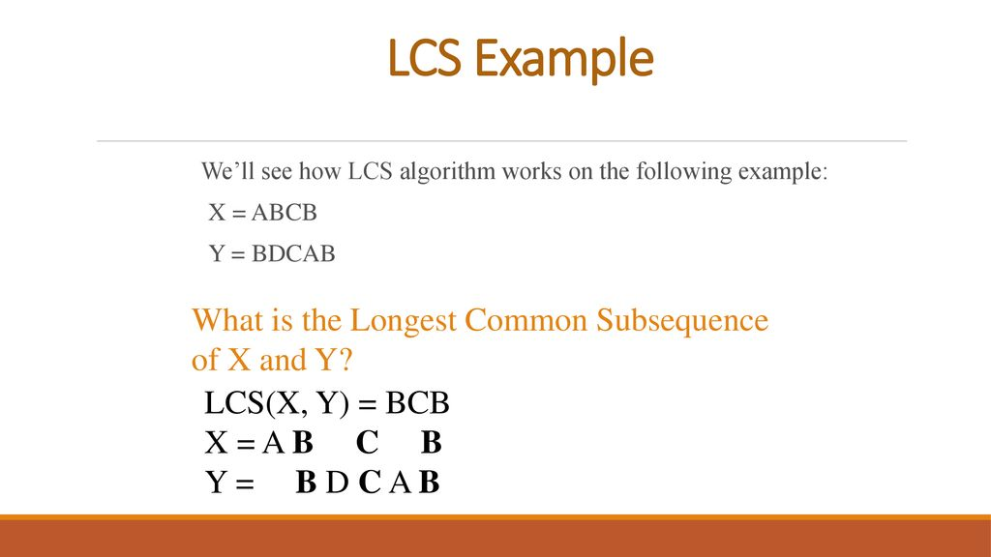

Slide 60
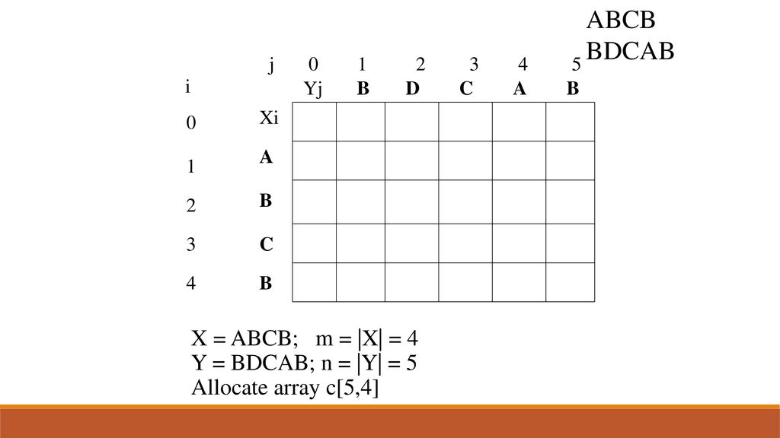

Slide 61
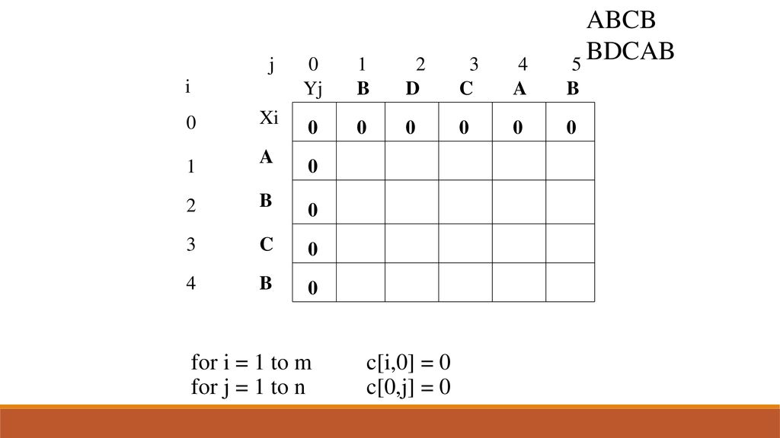

Slide 62
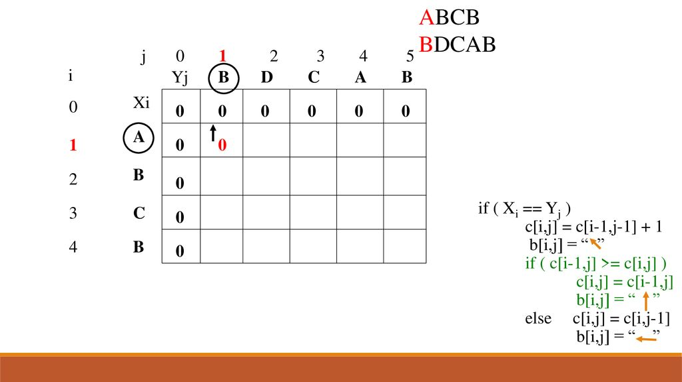

Slide 63
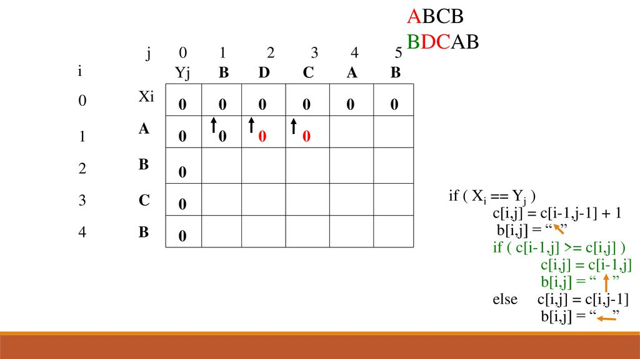

Slide 64
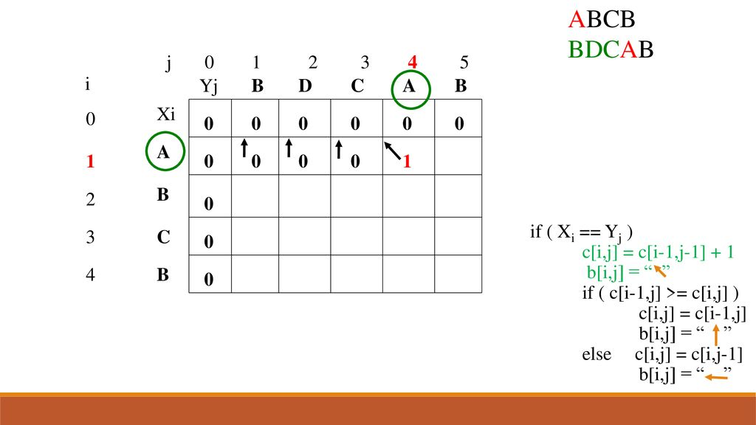

Slide 65
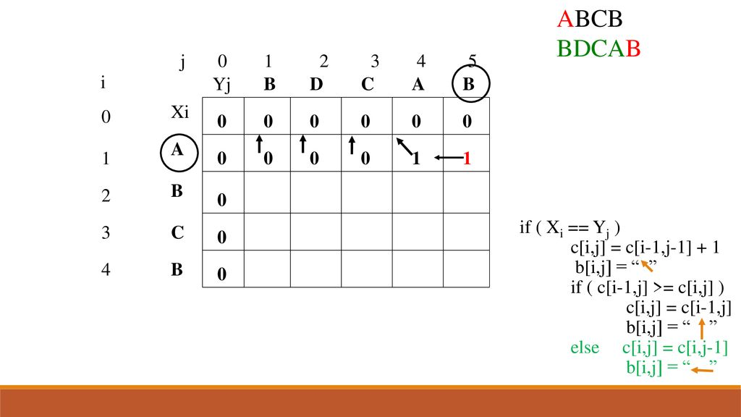

Slide 66
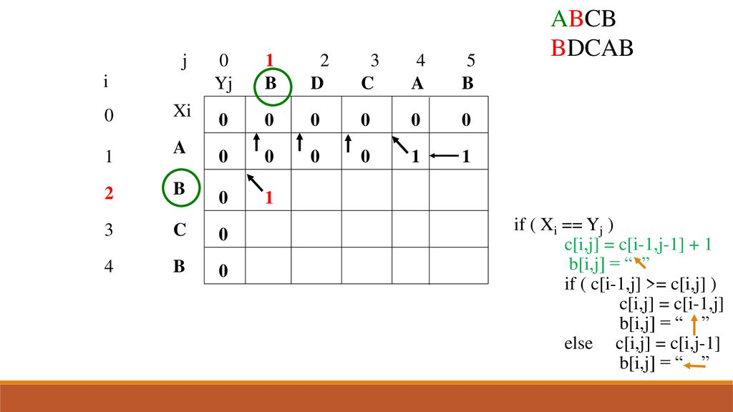

Slide 67
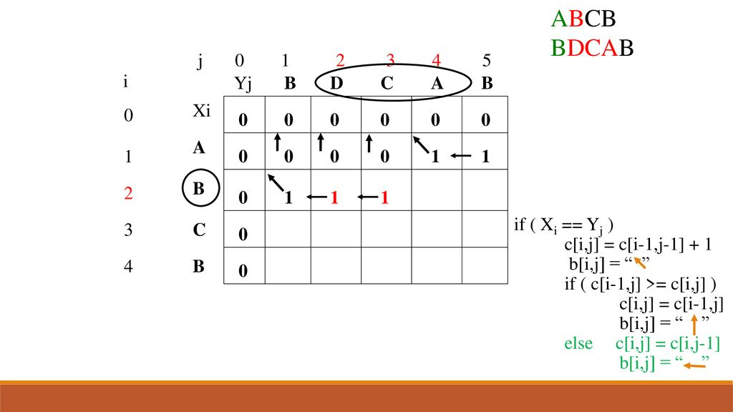

Slide 68
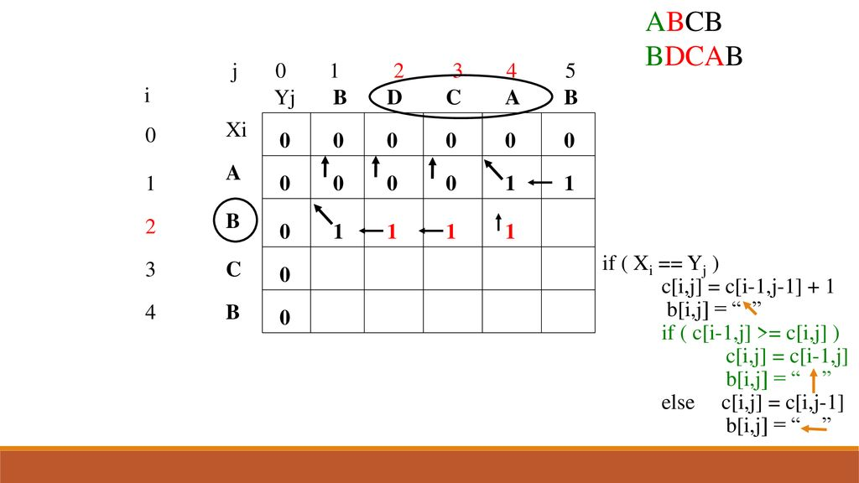

Slide 69
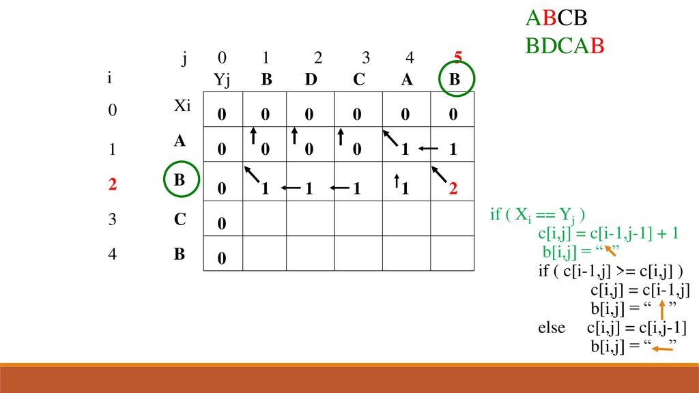

Slide 70
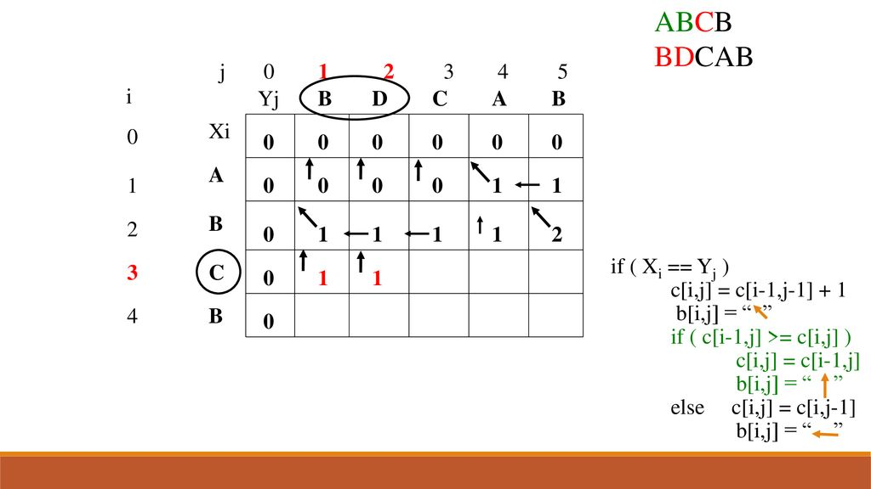

Slide 71
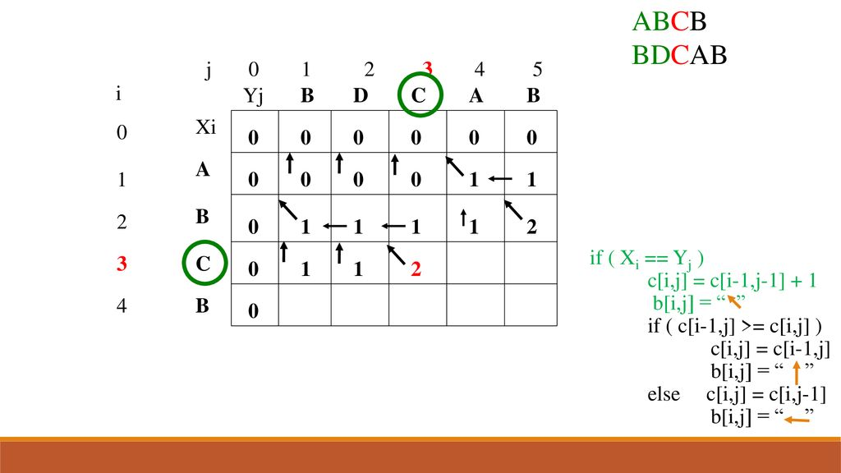

Slide 72
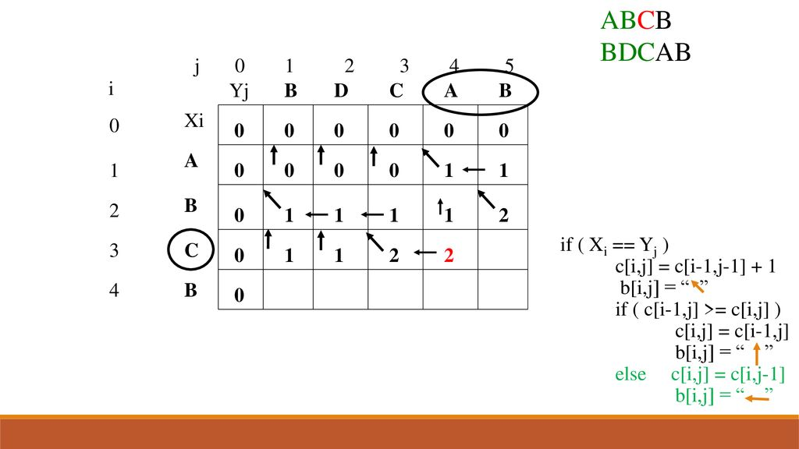

Slide 73
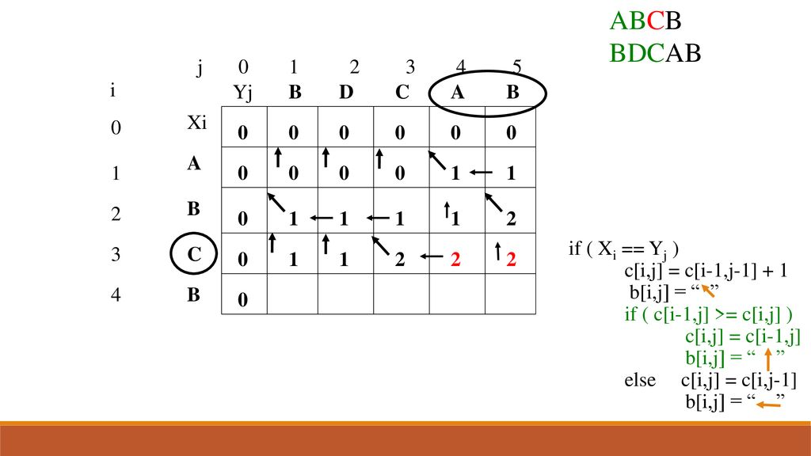

Slide 74
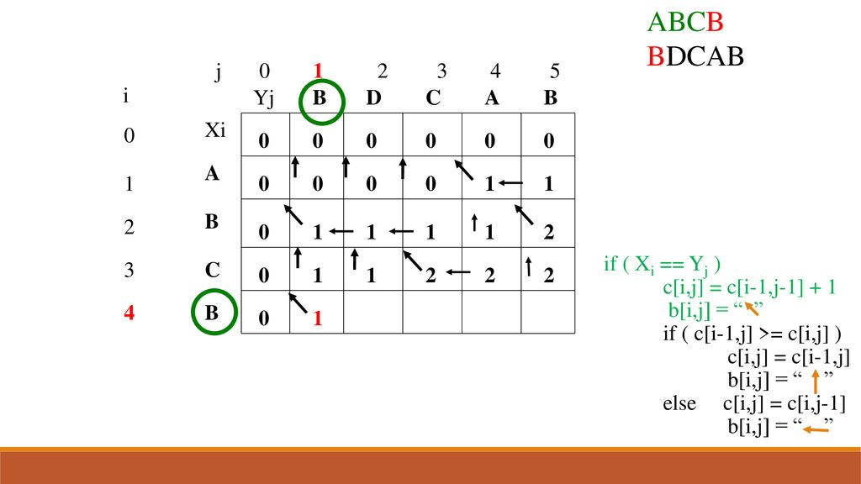

Slide 75
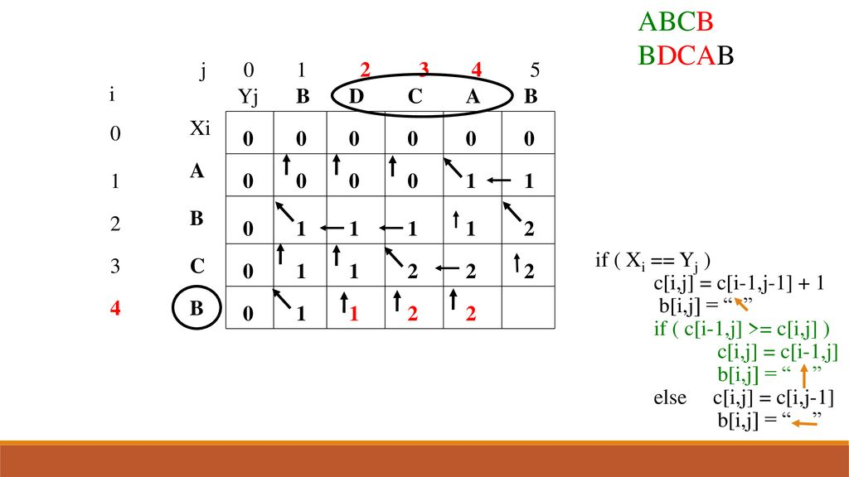

Slide 76
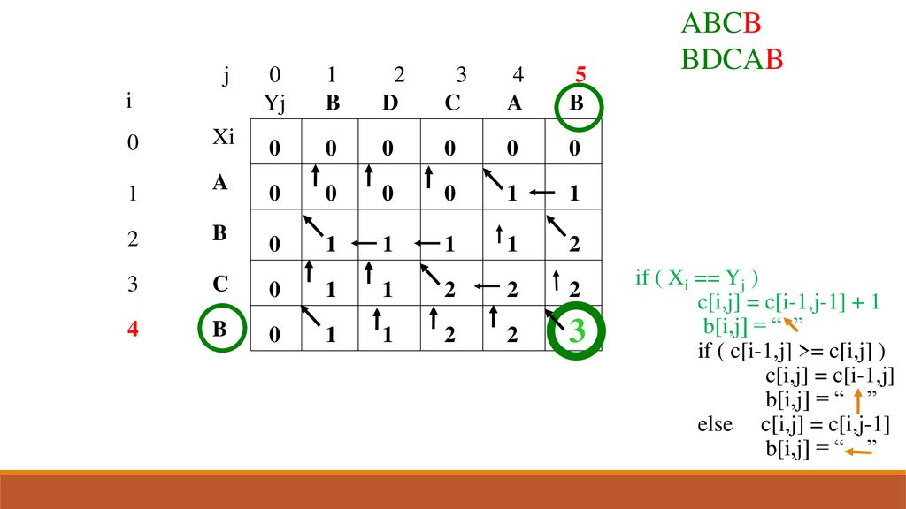

Slide 77
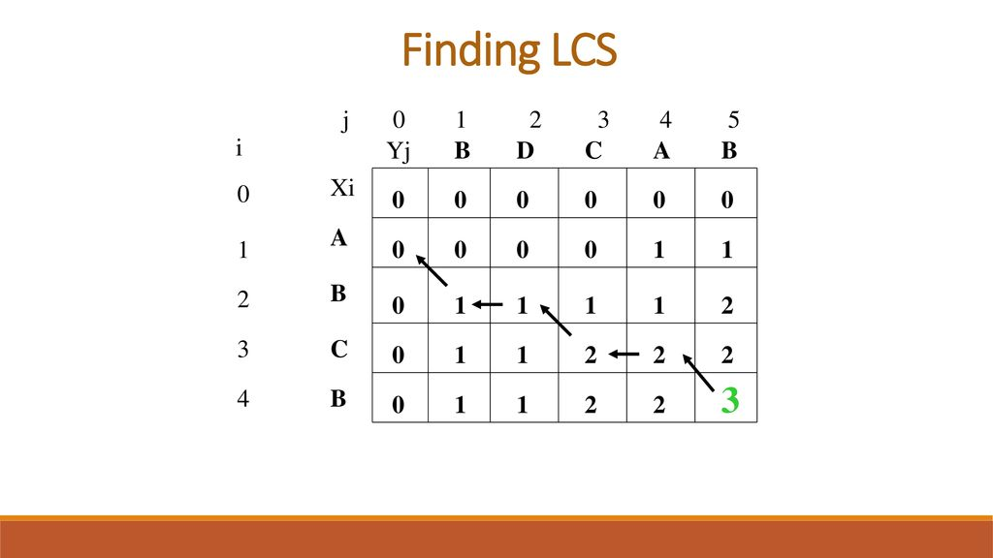

Slide 78
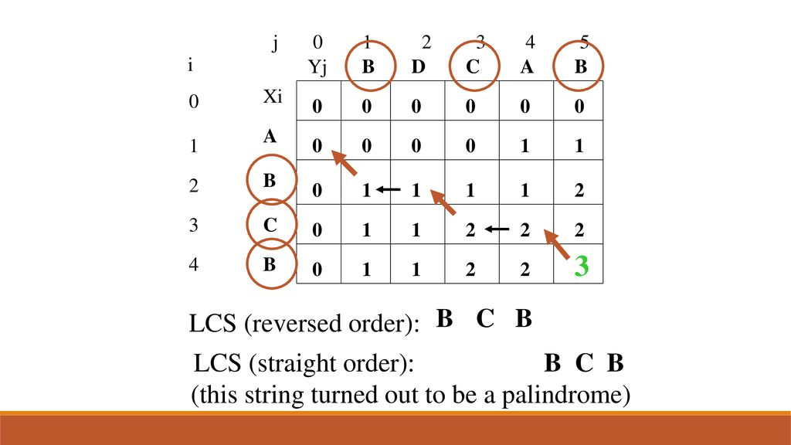

Slide 79
Example
0 if i = 0 or j = 0
c[i, j] = c[i-1, j-1] + 1 if x_{i} = y_{j}
max(c[i, j-1], c[i-1, j]) if x_{i} ≠ y_{j}
X = ⟨A, B, C, B, D, A , B⟩
Y = ⟨B, D, C, A, B, A⟩
y_{j}
B
D
C
A
B
A
0
1
2
3
4
5
6
If x_{i} = y_{j}
b[i, j] = “ ”
else if c[i - 1, j] ≥ c[i, j-1]
b[i, j] = “ ↑ ”
else
b[i, j] = “ ← ”
x_{i}
0
0
0
0
0
0
0
0
A
1
0
↑
0
↑
0
↑
0
1
←1
1
B
2
0
1
↑
1
2
←1
←1
←2
C
3
0
↑
1
↑
1
2
↑
2
↑
2
←2
B
4
0
1
↑
1
↑
2
↑
2
3
←3
D
5
0
↑
1
2
↑
2
↑
2
↑
3
↑
3
A
6
0
↑
1
↑
2
↑
2
3
↑
3
4
B
7
0
1
↑
2
↑
2
↑
3
4
↑
4

Slide 80
Constructing a LCS
Start at b[m, n] and follow the arrows
When we encounter a “ “ in b[i, j] ⇒ x_{i} = y_{j} is an element of the LCS
0
1
2
3
4
5
6
y_{j}
B
D
C
A
B
A
0
x_{i}
0
0
0
0
0
0
0
1
A
0
↑
0
↑
0
↑
0
1
1
←1
2
B
0
1
←1
←1
↑
1
2
←2
3
C
0
↑
1
↑
1
2
←2
↑
2
↑
2
4
B
0
1
↑
1
↑
2
↑
2
3
←3
5
D
0
↑
1
2
↑
2
↑
2
↑
3
↑
3
6
A
0
↑
1
↑
2
↑
2
3
↑
3
4
7
B
0
1
↑
2
↑
2
↑
3
4
↑
4

Slide 81
LCS-LENGTH(X, Y, m, n)
for i ← 1 to m
do c[i, 0] ← 0
for j ← 0 to n
do c[0, j] ← 0
for i ← 1 to m
do for j ← 1 to n
do if x_{i} = y_{j}
then c[i, j] ← c[i - 1, j - 1] + 1
b[i, j ] ← “ ”
else if c[i - 1, j] ≥ c[i, j - 1]
then c[i, j] ← c[i - 1, j]
b[i, j] ← “↑”
else c[i, j] ← c[i, j - 1]
b[i, j] ← “←”
return c and b
The length of the LCS if one of the sequences
is empty is zero
Case 1: x_{i} = y_{j}
Case 2: x_{i} ≠ y_{j}
Running time: Θ(mn)

Slide 82
PRINT-LCS(b, X, i, j)
Running time: Θ(m + n)
if i = 0 or j = 0
then return
if b[i, j] = “ ”
then PRINT-LCS(b, X, i - 1, j - 1)
print x_{i}
elseif b[i, j] = “↑”
then PRINT-LCS(b, X, i - 1, j)
else PRINT-LCS(b, X, i, j - 1)
Initial call: PRINT-LCS(b, X, length[X], length[Y])

Slide 83
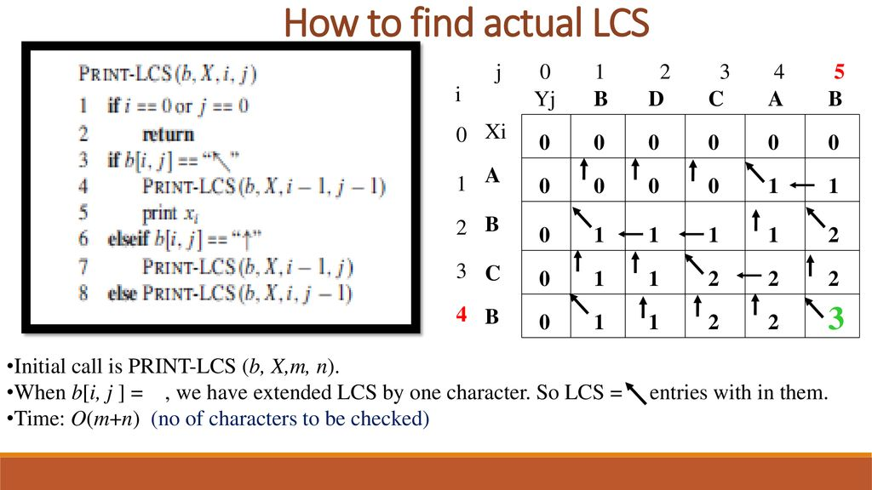

Slide 84
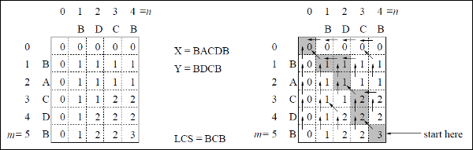
Largest/Longest Common Subsequence (LCS)
Example:
Given two strings are X = BACDB and Y = BDCB
find the longest common subsequence.
84

Slide 85
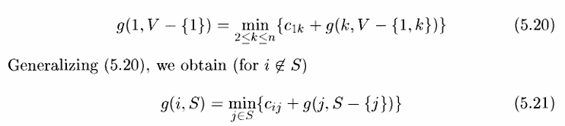
Travelling Salesman Problem
(Ref. Horowithz Sahni , page no-319)
In the traveling salesman problem, a map of cities is given to the salesman and he has to visit all the cities only once and return to his starting point to complete the tour in such a way that the length of the tour is the shortest among all possible tours for this map.
Clearly starting from a given city, the salesman will have a total of (n-1)! Different sequences:
If n = 2, A and B, there is no choice.
If n = 3, i.e. he wants to visit three cities
inclusive of the starting point, he has 2! Possible routes and so on.
85

Slide 86
Travelling Salesman Problem
(Ref. Horowithz Sahni , page no-319)
The Dynamic Programming proceeds as follows:-
Step-1
Consider the given travelling salesman problem in which he wants to find that route which has shortest distance.
Step-2
Consider set of 0element, such that
g(2, Φ ) = c21 g(3, Φ ) = c31 g(4, Φ ) = c41
Step-3
After completion of step-2, consider sets of 1 elements, such that
Set {2}: g(3,{2}) = c32 + g(2, Φ ) = c32 + c21
g(4,{2}) = c42 + g(2, Φ ) = c42 + c21
Set {3}: g(2,{3}) = c23 + g(3, Φ ) = c23 + c31
g(4,{3}) = c43 + g(3, Φ) = c43 + c31
Set {4}: g(2,{4}) = c24 + g(4, Φ ) = c24 + c41
g(3,{4}) = c34 + g(4, Φ ) = c34 + c41
Step-4
After completion of step-3, consider sets of 2 elements, such that
Set {2,3}: g(4,{2,3}) = min {c42 + g(2,{3}), c43 + g(3,{2})}
Set {2,4}: g(3,{2,4}) = min {c32 + g(2,{4}), c34 + g(4,{2})}
Set {3,4}: g(2,{3,4}) = min {c23 + g(3,{4}), c24 + g(4,{3})}
Step-5
After completion of step-4, Find the length of an optimal tour:
f = g(1,{2,3,4}) = min { c12 + g(2,{3,4}), c13 + g(3,{2,4}), c14 + g(4,{2,3}) }
Step-6
After completion of step-5, Find the Optimal TSP tour
86

Slide 87
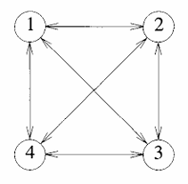
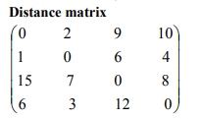
Travelling Salesman Problem
(Ref. Horowithz Sahni , page no-319)
Consider the directed graph of Figure (a). The edge lengths are given by matrix c of Figure (b) . Solve the TSP problem for the given Distance matrix.
g(2, Φ ) = c21 = 1
g(3, Φ ) = c31 = 15
g(4, Φ ) = c41 = 6
Using (5.21), we obtain
k = 1, consider sets of 1 element:
Set {2}: g(3,{2}) = c32 + g(2, Φ ) = c32 + c21 = 7 + 1 = 8
g(4,{2}) = c42 + g(2, Φ ) = c42 + c21 = 3 + 1 = 4
Set {3}: g(2,{3}) = c23 + g(3, Φ ) = c23 + c31 = 6 + 15 = 21
g(4,{3}) = c43 + g(3, Φ) = c43 + c31 = 12 + 15 = 27
Set {4}: g(2,{4}) = c24 + g(4, Φ ) = c24 + c41 = 4 + 6 = 10
g(3,{4}) = c34 + g(4, Φ ) = c34 + c41 = 8 + 6 = 14
Next, we compute g(i,S) with \\S\\ =2,i^1,105and i 0S.
k = 2, consider sets of 2 elements:
Set {2,3}: g(4,{2,3}) = min {c42 + g(2,{3}), c43 + g(3,{2})} = min {3+21, 12+8}= min {24, 20}= 20
Set {2,4}: g(3,{2,4}) = min {c32 + g(2,{4}), c34 + g(4,{2})} = min {7+10, 8+4}= min {17, 12} = 12
Set {3,4}: g(2,{3,4}) = min {c23 + g(3,{4}), c24 + g(4,{3})} = min {6+14, 4+27}= min {20, 31}= 20
Finally, from (5.20) we obtain
Length of an optimal tour:
f = g(1,{2,3,4}) = min { c12 + g(2,{3,4}), c13 + g(3,{2,4}), c14 + g(4,{2,3}) }
= min {2 + 20, 9 + 12, 10 + 20}
= min {22, 21, 30} = 21
Successor of node 1: c13 + g(3,{2,4}) = 3
Successor of node 3: = c34 + g(4,{2})} =4
Successor of node 4: g(4,{2}) =2
Successor of node 2: back to starting node 1 Optimal TSP tour: 1 →3 → 4 →2→1 with minimum cost= 21
Figure (a) Figure (b)
87

Slide 88
Dynamic Programming
Principle of optimality
0/1 Knapsack
Largest Common Subsequence
Travelling Salesperson Problem
Multistage Graph problem (using Forward computation)
(Ref. Horowithz Sahni and Parag Dave )

Slide 89
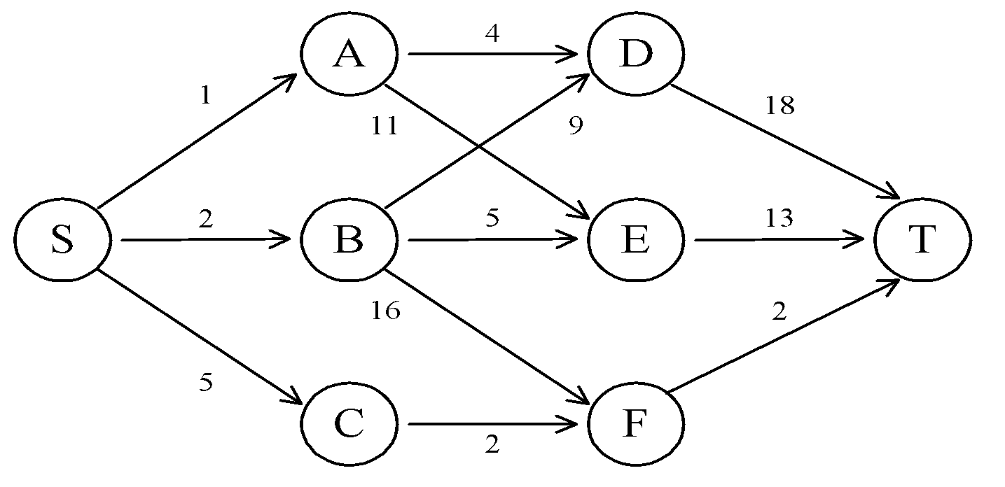
The shortest path in Multistage Graphs
e.g.
The greedy method can not be applied to this case: (S, A, D, T) 1+4+18 = 23.
The real shortest path is:
(S, C, F, T) 5+2+2 = 9.
7 -89
Notes:
89

Slide 90
Multistage Graph :Introduction
A multistage graph is a directed and weighted graph, in which all vertices are divided into stages, such that all the edges are only directed from the vertex of the current stage to the vertex of the next stage (i.e there is no edge between the vertex of the same stage and to the previous stage vertex).
Both the first and last stage contains only one vertex called source and destination/sink respectively.
Mathematically, a multistage graph can be defined as:
Multistage graph G = (V, E, W) is a weighted directed graph in which vertices are partitioned into k ≥ 2 disjoint subsets V = {V1, V2, …, Vk} such that if edge (u, v) is present in E then u ∈ Vi and v ∈ Vi+1, 1 ≤ i ≤ k.
The sets V1 and Vk are such that |V1 | = |Vk|=1
7 -90
Notes:
90

Slide 91
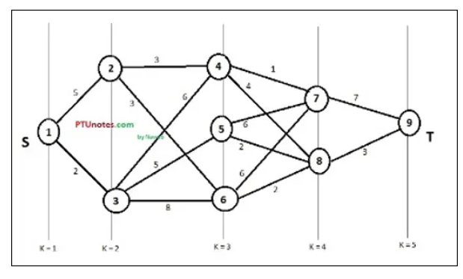
Multistage Graph :Introduction
A multistage graph with 9 vertices and K=5 stages
7 -91
Notes:
91

Slide 92
Multistage Graph : Dynamic programming approach
In the multistage graph problem, we are required to find the shortest path between the source and the sink/destination.
This problem can be easily solved by dynamic programming. Before getting started, let’s understand what is Dynamic Programming(DP).
Dynamic Programming:
Dynamic Programming is an optimization over recursion.
Whenever we have an optimization problem with repeated sub-problems we use dynamic programming because, in dynamic programming, we store the solution to smaller sub-problems in a table, and use it when the same sub-problem arrives.
Dynamic programming reduces the exponential time complexity of a recursive algorithm to polynomial time complexity.
7 -92
Notes:
92

Slide 93
Multistage Graph : Dynamic programming approach
Dynamic programming can be applied to many problems like travelling salesman problems and multistage graph problems.
The multistage graph problem can be solved in two ways using dynamic programming :
Forward approach
Backward approach
7 -93
Notes:
93

Slide 94
Multistage Graph : Forward Approach
In the forward approach, we assume that there are k stages in the graph.
We start from the last stage and find out the cost of each and every node to the first stage.
We then find out the minimum cost path from the source to destination (i.e from stage 1 to stage k).
Procedure:
Maintain a cost array cost[n] which stores the distance from any vertex to the destination.
If a vertex has more than one path, then the path with the minimum distance is chosen and the intermediate vertex is stored in the distance array D[n]. This will give us a minimum cost path from each and every vertex.
7 -94
Notes:
94

Slide 95
Multistage Graph : Forward Approach
Finally, the cost from 1st vertex cost(1,k) gives the minimum cost of the shortest path from source to destination.
For finding the path, start from vertex-1 then the distance array D(1) will give the minimum cost neighbor vertex which in turn gives the next nearest vertex and proceed in this way till we reach the destination. For a ‘k’ stage graph, there will be ‘k’ vertex in the path.
For forward approach,
Cost (i , j) = min {C (j , l) + Cost (i+1 , l) }
i ∈ Vi + 1 & <j , l> ∈ E
7 -95
Notes:
95

Slide 96
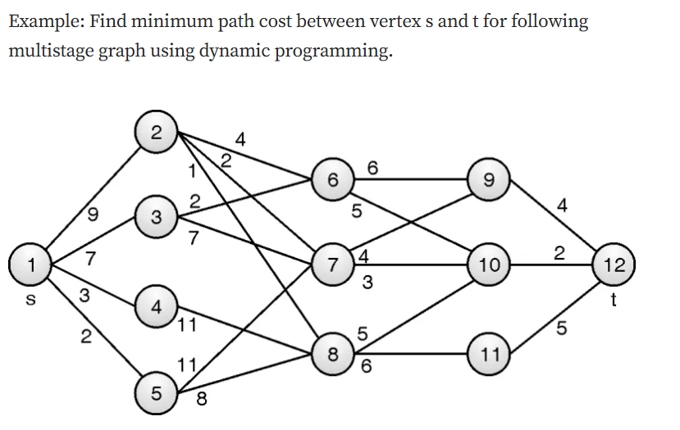
In the above graph, cost of an edge is represented as c(i, j).
We need to find the minimum cost path from vertex 1 to vertex 12.
Using the below formula we can find the shortest cost path from source to destination:
cost(i,j)=min{c(j,l)+cost(i+1,l)}
7 -96
Notes:
96

Slide 97
Step 1:
Stage 5
cost(5,12)=c(12,12)=0
We use forward approach here therefore (cost(5,12) = 0 ).
Here, 5 represents the stage number and 12 represents a node in that stage.
Since there are no outgoing edges from vertex 12, the cost is 0 and
D[12]=12
7 -97
Notes:
97

Slide 98
Step 2:
Stage 4
cost(4,9)= c(9,12) = 4 & D[9]=12
cost(4,10) = c(10,12) = 2 & D[10]=12
cost(4,11) = c(11,12) = 5 & D[11]=12
Step 3:
Stage 3
cost(3,6)=min{c(6,9)+cost(4,9), c(6,10)+cost(4,10)}
= min{6+4,5+2} =min{10,7}=7
D[6]=10
cost(3,7)=min{c(7,9)+cost(4,9), c(7,10)+cost(4,10)}
= min{4+4,3+2} =min{8,5}=5
D[7]=10
cost(3,8)=min{c(8,10)+cost(4,10), c(8,11)+cost(4,10)}
= min{5+2,6+5} =min{7,11}=7
D[7]=10
7 -98
Notes:
98

Slide 99
Step 4:
Stage 2
cost(2,2) = min {c(2,6)+cost(3,6), c(2,7)+cost(3,7), c(2,8)+cost(3,8)}
= min{4+7,2+5,1+7}=min{11,7,8}=7
D[2]=7
cost(2,3) = min{c(3,6)+cost(3,6), c(3,7)+cost(3,7)}
= min{2+7,7+5}=min{9,12}=9
D[3]=6
cost(2,4) = min{c(4,8)+cost(3,8)}
= min{11+7}=min{18}=18
D[4]=8
cost(2,5) = min{c(5,7)+cost(3,7), c(5,8)+cost(3,8)}
= min{11+5,8+7}=min{16,15}=15
D[3]=8
7 -99
Notes:
99

Slide 100
Step 5:
Stage 1
cost(1,1) = min { c(1,2)+cost(2,2),
c(1,3)+cost(2,3),
c(1,4)+cost(2,4),
c(1,5)+cost(2,5)}
= min { 9+7, 7+9, 3+18, 2+15}
=min{16,16,21,17}
=16
D[1] = 2 (we can take 3 also )
7 -100
Notes:
100

Slide 101
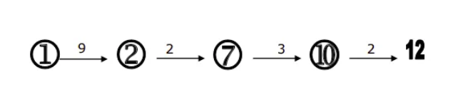
The path through which we have to find the shortest distance
Start from vertex — 2
D ( 1) = 2
D ( 2) = 7
D ( 7) = 10
D (10) = 12
So, the minimum –cost path is,
The cost is 9+2+3+2=16
ANALYSIS: The time complexity of this forward method is 𝑂(|𝑉| + |𝐸|)
7 -101
Notes:
101

Slide 102
Algorithm Fgraph(G,k,n,p)
//input is k stage graph G=(V,E) with n vertices
//indexed in order of stages
// E set of edges, c[i][j] is cost of <i,j>
// p[1..k] is a minimum cost path
{
fcost[n] = 0.0;
for j= n-1 to 1 step -1 do
{ // compute fcost[j]
Let r be the vertex such that <j, r> is an edge
of G and c[j][r] + fcost[r] is minimum;
fcost[j] = c[j][r] + fcost[r];
d[j]=r ;
}
p[1]=1; p[k] = n;
for j= 2 to k-1 do p[j] = d[p[j-1]];
}
7 -102

Slide 103
Complexity
G represented using adjacency list
Vertex r can be found in time proportional to the degree of vertex j.
If G has |E| edges, the total time required is Ѳ(|v| +|E|)
Additional space required for cost[],d[],p[]
7 -103

